Slide 1

VETRI VINAYAHA COLLEGE OF ENGINEERING AND TECHNOLOGY
ANNA UNIVERSITY : CHENNAI OCT 2023

Slide 2
SUBMITTED BY
SURIYA V 623320104023
SANTHOSHKUMAR L 623320104018
BANUPPIRIYA C 623320104004
SAKTHIVEL S 623320104303
Guided by
MR.P. SURIYA
AP/CSE

Slide 3
FOOD TRACKING SYSTEM

Slide 4
INTRODUCTION
The food industry is undergoing a significant transformation, with increasing demand for transparency and traceability throughout the supply chain.
Food safety, authenticity, and sustainability are paramount concerns for consumers, regulators, and producers alike.
Blockchain technology, with its decentralized and immutable ledger, offers a promising solution to address these concerns.
This paper presents a novel approach to implementing a food tracking system using smart contracts on the Ethereum block chain.

Slide 5
EXISTING SYSTEM
An existing problem project can address is the lack of transparency and traceability in the food supply chain.
Currently, consumers often have limited access to detailed information about the journey of their food products from farm to table.
This lack of transparency can lead to concerns about food safety, authenticity, and sustainability.
Instances of foodborne illnesses or recalls further highlight the need for a more robust tracking system.
By implementing a food tracking system with Ethereum’s smart contracts, you can provide a solution to this problem

Slide 6
EXISTING SYSTEM DISADVANTAGE
Inefficient supply chain practices can lead to significant food waste and loss, both of which contribute to environmental issues and increased costs for producers and consumers.
All of these disadvantages collectively contribute to a reduction in consumer confidence in the food supply chain.
Traditional systems often lack the ability to quickly trace the source of a food product in the event of a contamination or safety issue.
One of the most significant disadvantages is the lack of transparency in the traditional food supply chain.

Slide 7
PROPOSED SYSTEM
In the current food industry landscape, concerns regarding transparency, traceability, food safety, authenticity, and sustainability persistently challenge stakeholders across the supply chain.
This problem statement succinctly outlines the current challenges in the food industry and clearly articulates the goals and objectives of your project
This lack of transparency not only hinders consumer trust but also poses risks to food safety and the integrity of the supply chain
To address these critical concerns, this project aims to implement a food tracking system using smart contracts on the Ethereum blockchain.

Slide 8
PROPOSED SYSTEM ADVANTAGE
The blockchain-based system provides full transparency and real-time access to data for all stakeholders in the food supply chain.
The system can track and verify sustainability claims related to food products, such as organic, fair trade, or environmentally friendly practices
This helps consumers make more informed choices and supports ethical and sustainable practices in the food industry.

Slide 9
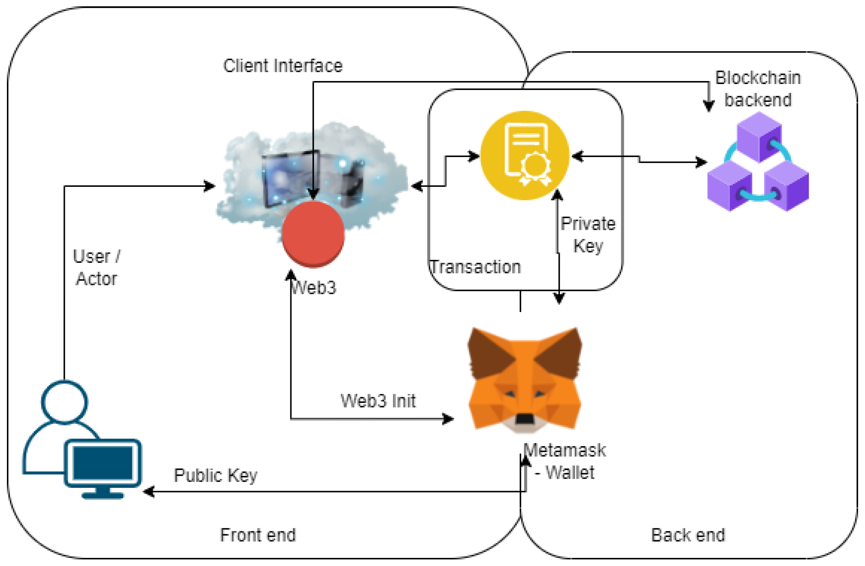
ARCHITECTURE

Slide 10
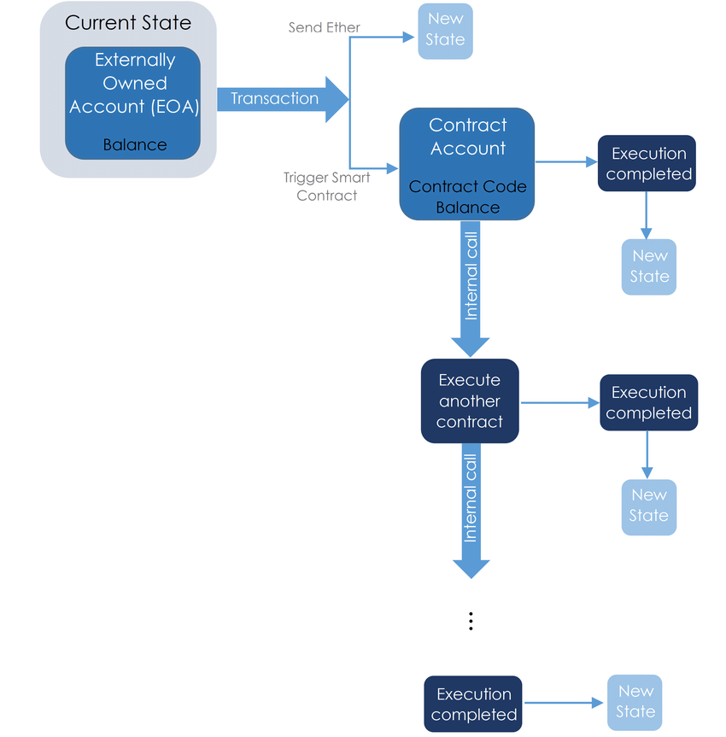
FLOW DIAGRAM

Slide 11
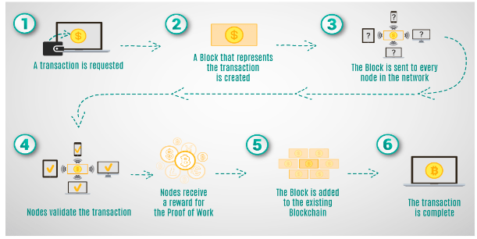
PROJECT PLANNING

Slide 12
CONCLUSION
In a rapidly evolving food industry landscape, the integration of blockchain technology and smart contracts presents a transformative solution to address critical concerns surrounding transparency, traceability, safety, authenticity, and sustainability.
The unique digital identities assigned to each item ensure that critical information, including origin, processing, and transportation details, is securely stored and readily accessible in real-time.

Slide 13
FUTURE SCOPE
Consider introducing a token-based system to incentivize active participation in the supply chain.
Tokens could be used to reward producers, logistics providers, and consumers for their contributions to data accuracy and transparency.
Develop AR/VR applications that allow consumers to virtually explore the journey of food products, providing an immersive and educational experience about the supply chain.

Slide 14
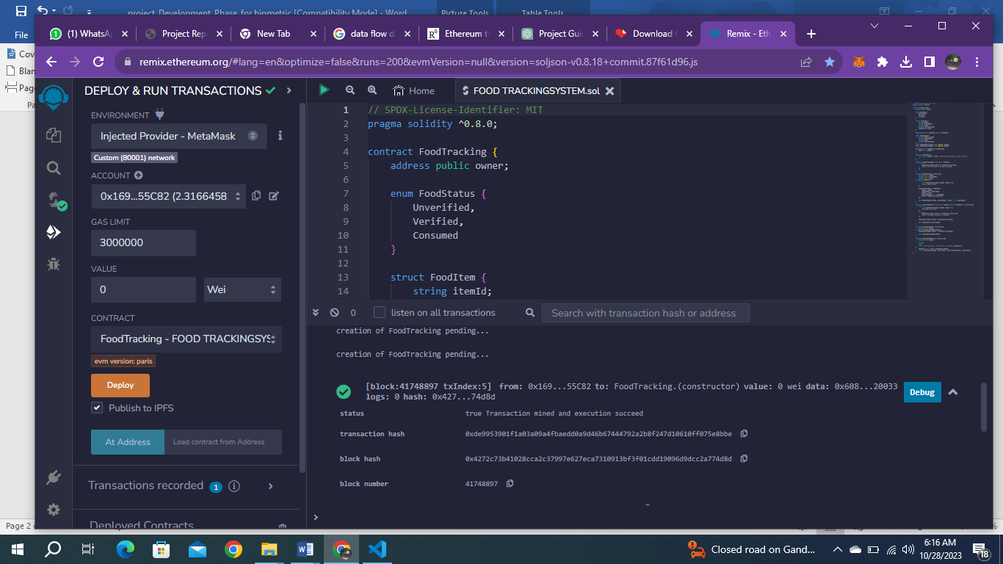
OUTPUT

Slide 15
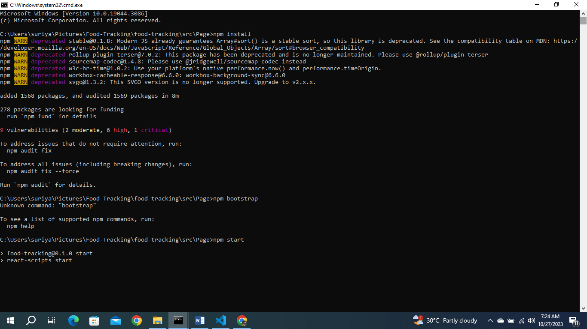

Slide 16
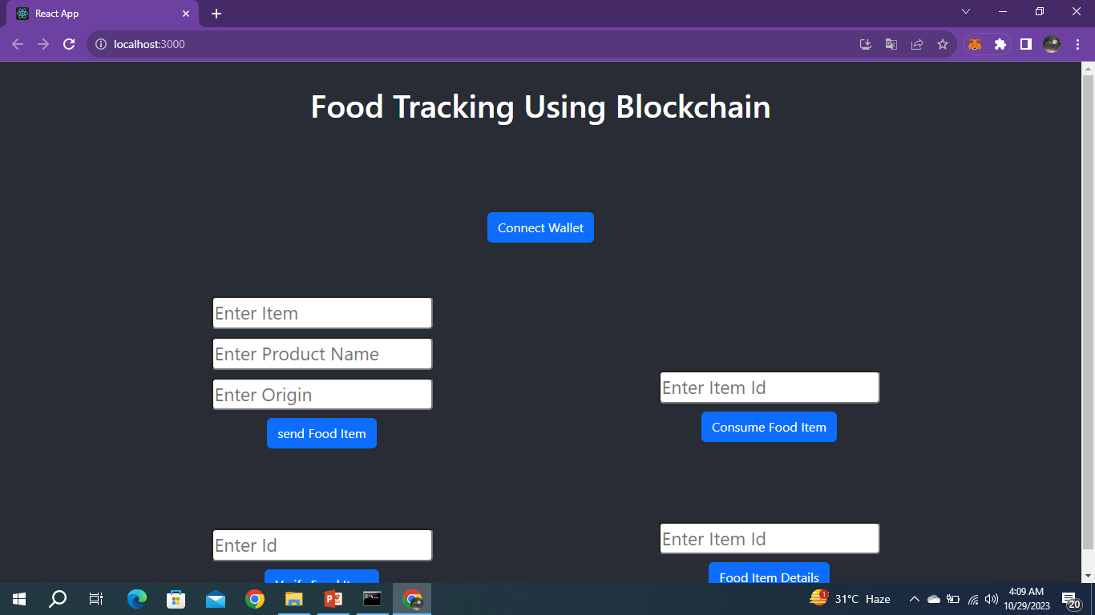

Slide 17
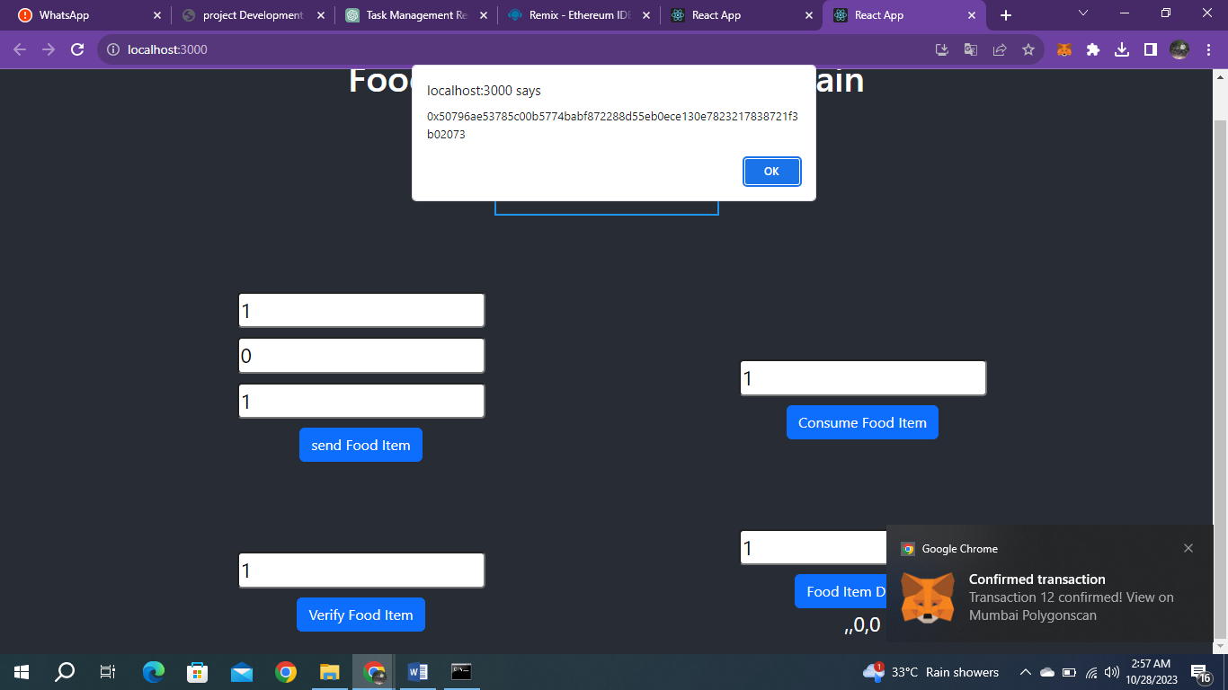

Slide 18


